Slide 1

Vel Tech Rangarajan Dr. Sagunthala R&D Institute of Science and Technology
School of Computing
Department of Computer Science and Engineering
10211CS224 / FULL STACK APPLICATION DEVELOPMENT(JAVA)
END SEMESTER PROJECT REVIEW
Date: 06-05-2026
SMART CAMPUS EVENT MANAGEMENT SYSTEM
SDG: SDG 9 – Industry, Innovation and Infrastructure
Courses Handling Faculty:
Dr. HEMAMALINI.S
Assistant Professor(Senior Grade)
Presented By:
CH. PREM SEKHAR – VTU25118 – 23UECS0111

Slide 2
INTRODUCTION
Campus Event Management is a full-stack web application built to streamline event creation, discovery, and registration.
It provides separate portals for Admins (organizers) and Students (attendees) with role-based access control.
Managing campus events manually is inefficient, error-prone, and lacks real-time visibility for organizers and students.
The system features real-time capacity tracking, event browsing, personalized dashboards, and auto-initialized mock data.
1
2
3
4
5
6
7
8
9

Slide 3
PROBLEM STATEMENT
Campus events such as hackathons, workshops, and tech summits are often managed manually using spreadsheets or paper-based systems, leading to poor visibility and coordination.
Students have no centralized platform to discover, filter, and register for events, resulting in missed opportunities and duplicate or overcrowded registrations.
Administrators lack real-time tools to monitor event capacity, manage attendees, and update event information efficiently.
There is a need for a secure, web-based event management system with role-based access, automated data handling, and an intuitive interface for both organizers and students.
1
2
3
4
5
6
7
8
9

Slide 4
OBJECTIVE(S)
To design and develop a full-stack web-based event management system that enables administrators to create, update, and monitor campus events with real-time capacity tracking.
To implement a secure, role-based authentication system using Spring Security that provides personalized dashboards for both Admin and Student users, enabling seamless event discovery and registration.
1
2
3
4
5
6
7
8
9

Slide 5
PROPOSED SYSTEM
A centralized web platform where admins manage events and students discover and register for them.
Role-based authentication: Admin portal for event CRUD and attendee management; Student portal for browsing and registration.
Personalized student dashboard tracking upcoming and completed event registrations with statistics.
Responsive red and white UI built with Bootstrap 5 and Thymeleaf, optimized for desktop and mobile devices.
1
2
3
4
5
6
7
8
9

Slide 6
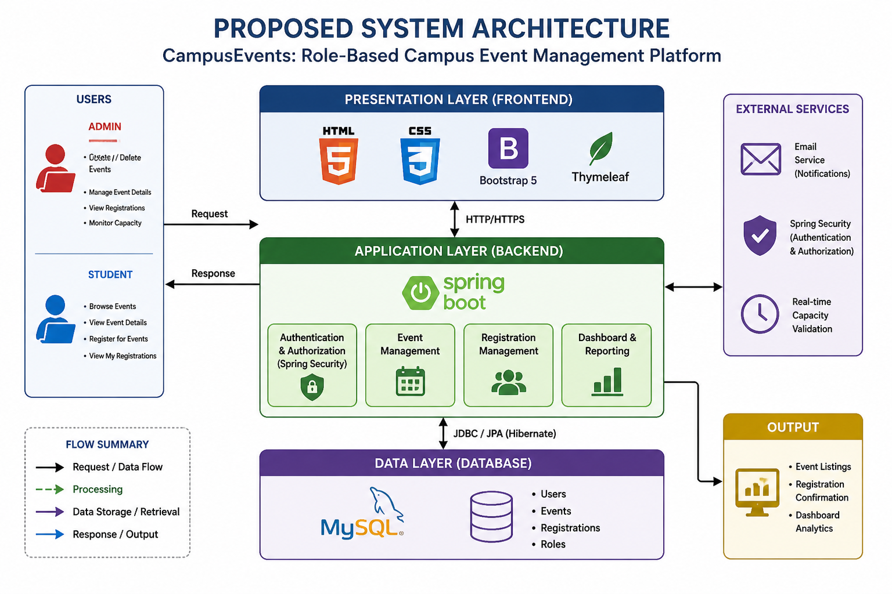
PROPOSED SYSTEM ARCHITECTURE
1
2
3
4
5
6
7
8
9

Slide 7
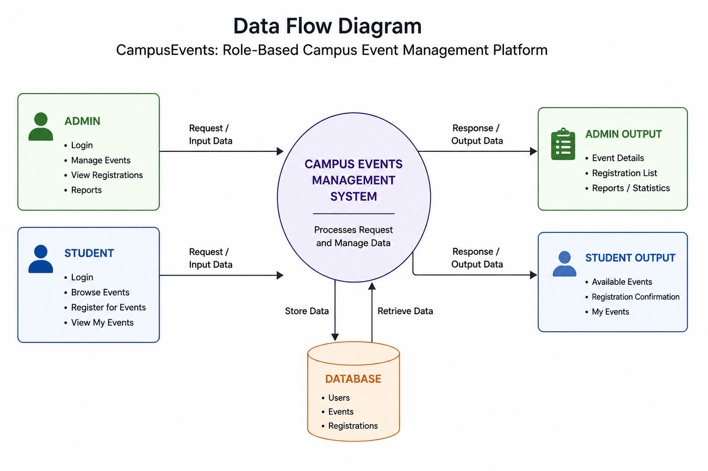
WORKFLOW
1
2
3
4
5
6
7
8
9

Slide 8
TECHNOLOGIES USED
Frontend:HTML,CSS,Bootstrap 5,Thymeleaf
Backend:Java,Spring Boot,Spring Security
Database:MySQL
Tools:IntelliJ,GitHub,Postman
Requirements:System with 8GB RAM,Java installed,Web browser
1
2
3
4
5
6
7
8
9

Slide 9
MODULE DESCRIPTION
Module 1: User Authentication
Handles login & registration
Role-based access (Admin / Student)
Module 2: Event Management
Admin creates, updates, deletes events
Controls event capacity
Module 3: Registration System
Students register for events
Prevents overbooking
Module 4: Dashboard & Tracking
Displays registered events
Shows participation statistics
1
2
3
4
5
6
7
8
9

Slide 10
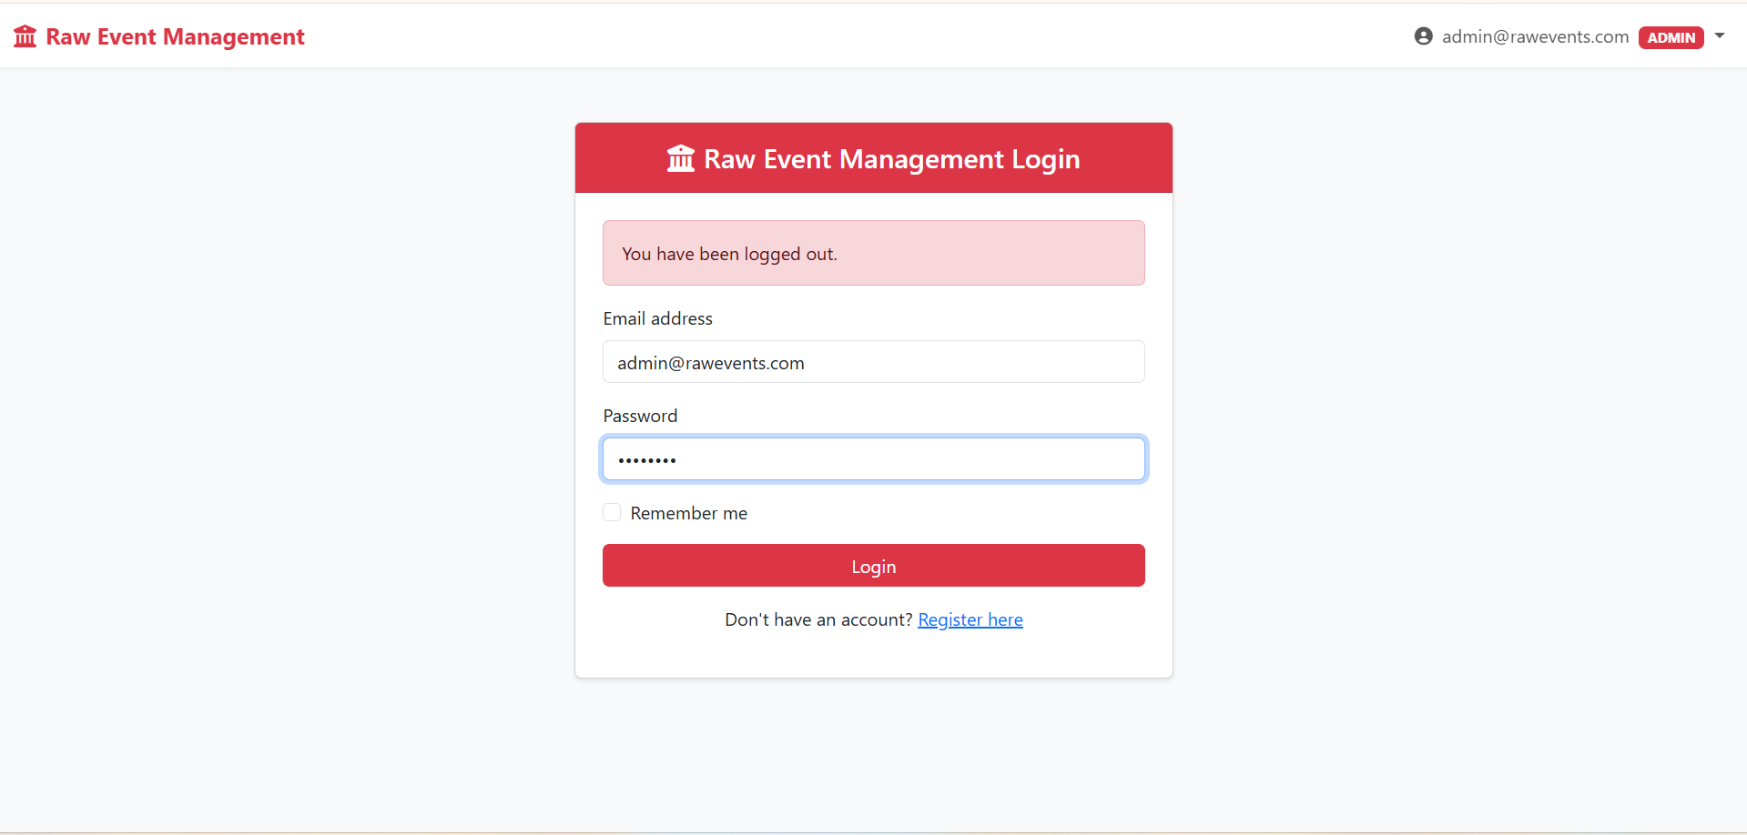
IMPLEMENTATION SCREENSHOTS
Login Page:Secure login interface for Admin and Student users with authentication validation.
1
2
3
4
5
6
7
8
9

Slide 11
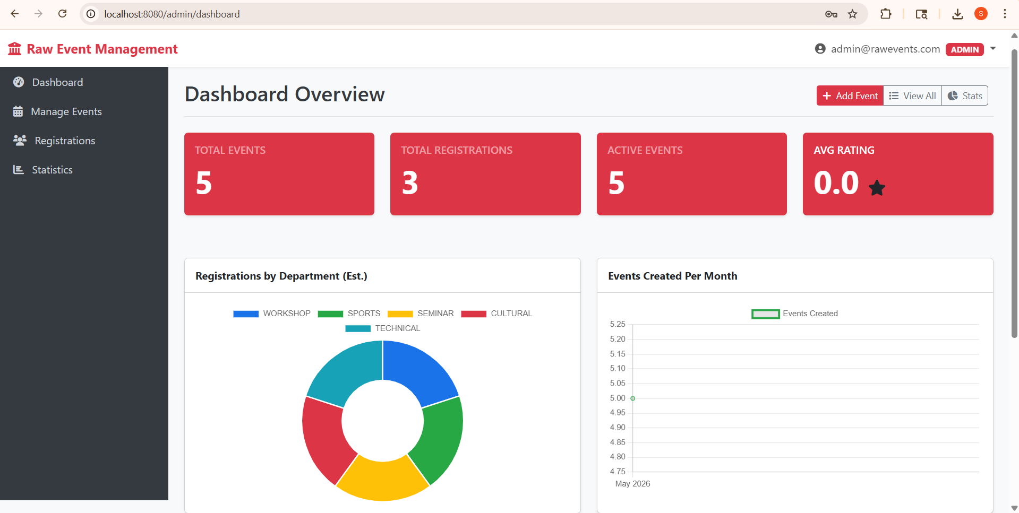
IMPLEMENTATION SCREENSHOTS
Admin Dashboard:Displays overall event statistics, registrations, and analytics for efficient event management.
1
2
3
4
5
6
7
8(A)
9

Slide 12
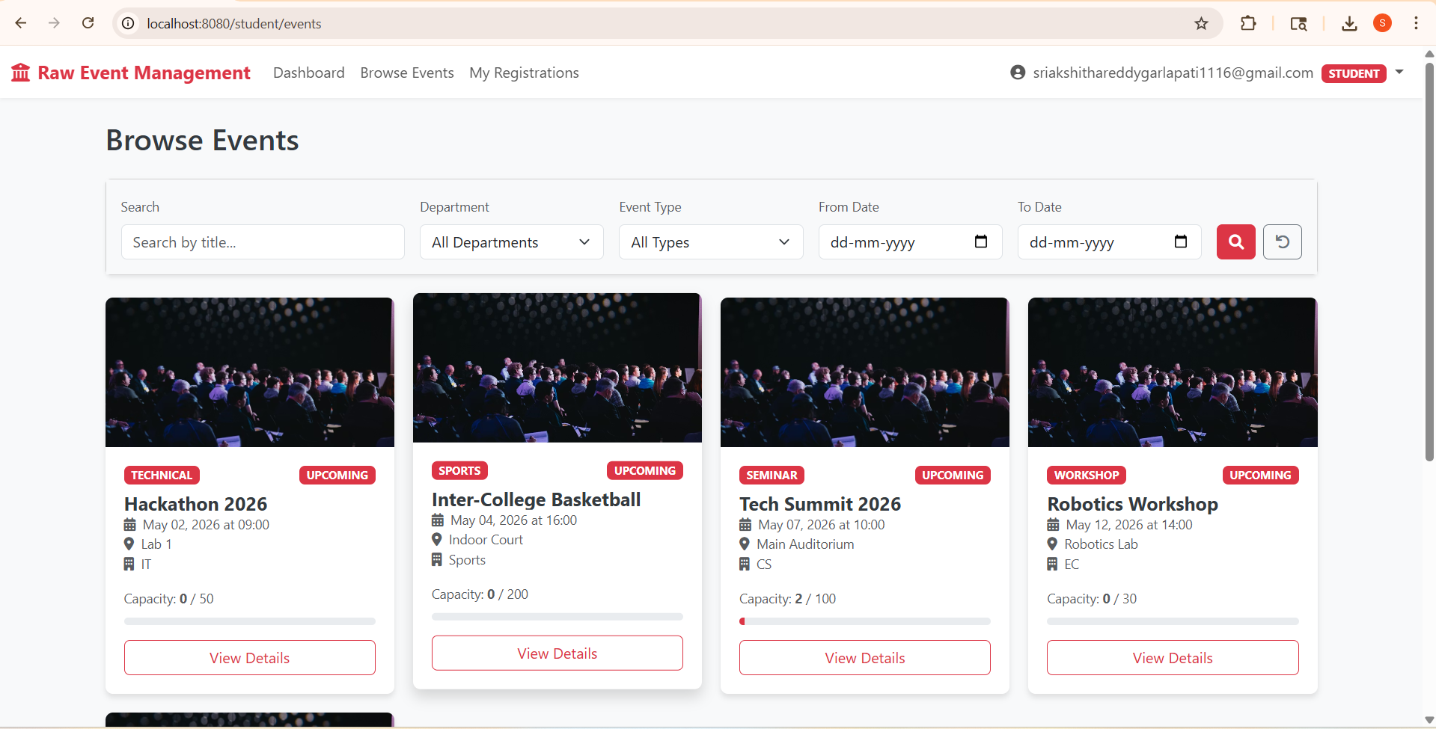
IMPLEMENTATION SCREENSHOTS
Student Browse Events Page:Allows students to search, filter, and view available events with real-time capacity details.
1
2
3
4
5
6
7
8(B)
9

Slide 13
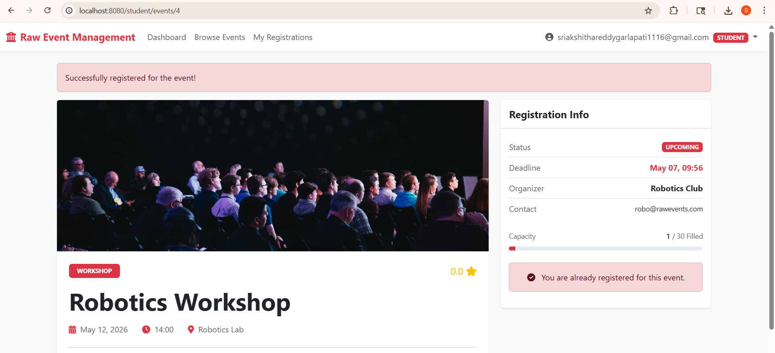
IMPLEMENTATION SCREENSHOTS
Event Registration Page:Allows students to view event details and register for events while ensuring capacity limits are maintained.
1
2
3
4
5
6
7
8(C)
9

Slide 14
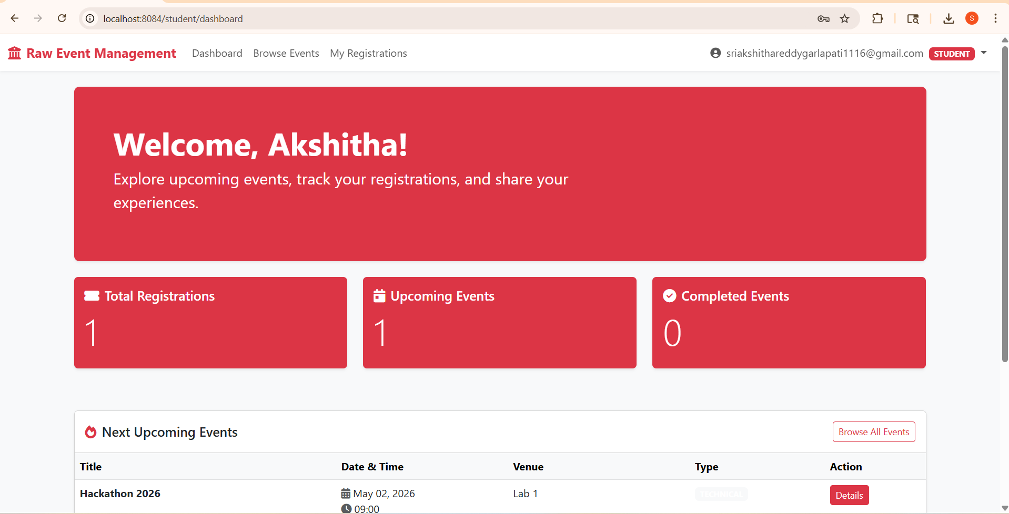
IMPLEMENTATION SCREENSHOTS

Slide 15
ADVANTAGES & LIMITATIONS
1
Advantages:
Easy to manage all events in one place
Secure login for Admin and Student roles
Prevents overbooking with capacity tracking
Ready-to-use system with sample data
Works on both mobile and desktop
Limitations:
No email notifications
No payment option for events
Requires local database setup
2
3
4
5
6
7
8
9

Slide 16
Thank you

